Slide 1



FINAL PROJECT PRESENTATION
Car Diagnosis Expert System
using Prolog
Artificial Intelligence CCE414 | May 2026

Slide 2
The Introduction
Problem Statement and Project Vision

Slide 3




Problem Statement
The Core Challenge
Car owners often face sudden vehicle malfunctions but lack the mechanical expertise to identify root causes.
This leads to:
Unnecessary stress and safety hazards.
Reliance on costly diagnostic services for simple fixes.
Long waiting times for professional inspections.

Slide 4


System Purpose & Target Users
Core Purpose
Design an expert system to diagnose common problems via yes/no questions.
It identifies faults and suggests repairs efficiently for various vehicle issues.
Primary Users
Focused on everyday car owners, drivers, and novice mechanics.
Designed for individuals requiring immediate troubleshooting assistance without advanced technical knowledge.

Slide 5




Resources & Expertise
Software
Developed using SWI-Prolog for the robust knowledge base.
Knowledge
Modeled after automotive manuals and diagnostic trees.
Emulation
Mimics the reasoning of an experienced auto-mechanic.

Slide 6
Knowledge Engineering
Rule-Based Diagnosis Logic

Slide 7






Diagnostic Knowledge Base (1-5)
Battery
If engine won't start and lights are dim.
Spark Plugs
If engine misfires and high fuel consumption.
Radiator
If car is overheating and leaking coolant.
Brake Pads
If squealing brakes and poor braking performance.
Flat Tire
If flapping noise and car pulls to side.

Slide 8




Diagnostic Knowledge Base (6-10)
Fuel Pump
If engine stalls and whining noise exists.
Oxygen Sensor
If check engine light on and black smoke.
Alternator
If battery light on and electrical issues.
Transmission
If hard shifting and leaking red fluid.
Worn Wiper
If poor visibility and streaking on glass.

Slide 9
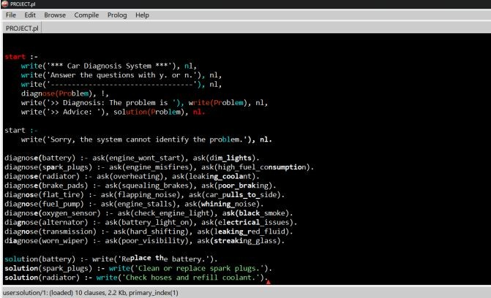



System Architecture
The system is built on Logic Programming
using Prolog:
Backward Chaining
Logic travels from Goal to Facts.
The Cut Operator (!)
A crucial mechanism that prevents backtracking once a match is found.
Recursion
Used to traverse the Knowledge Base efficiently.

Slide 10
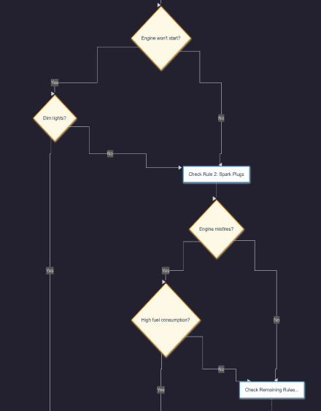




Diagnostic Algorithm
The algorithm follows a linear sequence from initialization to output, with a specific mechanism for handling rule matches.
If the rule matches, the Cut operator stops the search. If no rules match, the fallback predicate informs the user.
1. Start
Initialize start
2. Ask
Evaluate Diagnose Rules
3. Process
User Input (y/n)
4. Output
Print Advice

Slide 11

System Output & Results
Diagnosis Result | User Symptoms Provided | Recommended Advice
Battery | Engine won't start, Dim lights | Replace the battery
Spark Plugs | Engine misfires, High consumption | Clean/Replace spark plugs
Radiator | Overheating, Leaking coolant | Check hoses/refill coolant
Unsuccessful | No matching symptoms | System cannot identify

Slide 12
System Output & Results
Diagnosis Result
User Symptoms Provided
Recommended Advice
Battery
Engine won't start; Dim lights
Replace the battery
Spark Plugs
Engine misfires; High consumption
Clean/Replace spark plugs
Radiator
Overheating; Leaking coolant
Check hoses/refill coolant
Unsuccessful
No matching symptoms
System cannot identify

Slide 13
Thank You!
Questions?
Artificial Intelligence | Engineering CCE414
5 / 10 / 2026

